Slide 1
SOFTWARE ENGINEERING PROJECT HALL MANAGEMENT SYSTEM
B. SPANDANA - AP18110010269
CH. RUKMINI - AP18110010298
V. POOJITHA - AP18110010319

Slide 2
Scope of the project:
The existing method of going to a function hall, booking the hall, waiting for the conformation of hall booking, making payment etc., all these processes require a lot of time and manual work. Also, the maintenance of the records of the bookings and payments is a tedious job. Proposed system aims at solving the problems that are being faced in the existing method. It aims at providing an easy-to-use and convenient system for the customers who are willing to book a hall in online. The records of the payment and bookings are stored in the database automatically when a booking is placed/removed or when a payment is made. To help the customers in improving their quality of communication and attract customers the feedback from the customers can also be stored by this system.

Slide 3
Requirement Analysis
FUNCTIONAL REQUIREMENTS:
This is how the device will appear and function until it has been successfully completed.
The functional criteria must be met by the system are as follows:
1.Users:
When a customer visits an online hall management system, he will be asked to login or register for a better experience. A separate username and password must be created by the customer. The information such as name of the person, type of hall and date of the hall want and details must be filled by the customer. The customer can update the details of the booking or can cancel the reservation of the booking.
2. Administrators
The administrator must be able to log in and out.
The administrator must be able to add/delete/edit other users.
The administrator must be able to view an reservation details of all the customers.
Only users with respective rights (administrators) must be able to use all these “Admin” features

Slide 4
NON-FUNCTIONAL REQUIREMENTS:
Reliability: The factors needed to establish the software expected reliability are
The user inputs should be valid.
Normal termination of the program.
Availability: The factors guarantee the software’s availability includes proper termination and correct input details. It is available at any time except in case of data corruption or system failure.
Security: It must be ensured that access will be provided to the authorized persons through user ID and password.
Network security will be provided by the use of firewalls.
Checks can be performed at regular intervals to ensure data integrity.
Maintainability: The software will be developed by implementing the concept of modularity which in turn reduces the complexity involved in maintaining it. The administrator should have a sound technical knowledge about maintaining the software and further enhancements will be undertaken by the developer.
Portability: The application is portable which ensures its adaptability for use on different computer terminals with different operating systems and standards.

Slide 5
Test Cases
Test Case 1 : Booking, Confirmation
Test Case 2 : Search event hall
Test Case 3 : View, Update, Delete
Test Case 4 : Hall Cancellation

Slide 6
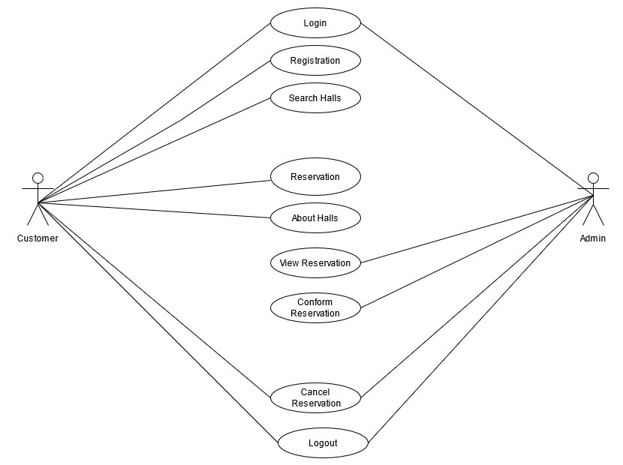
UML DIAGRAMS: Use Case Diagram

Slide 7
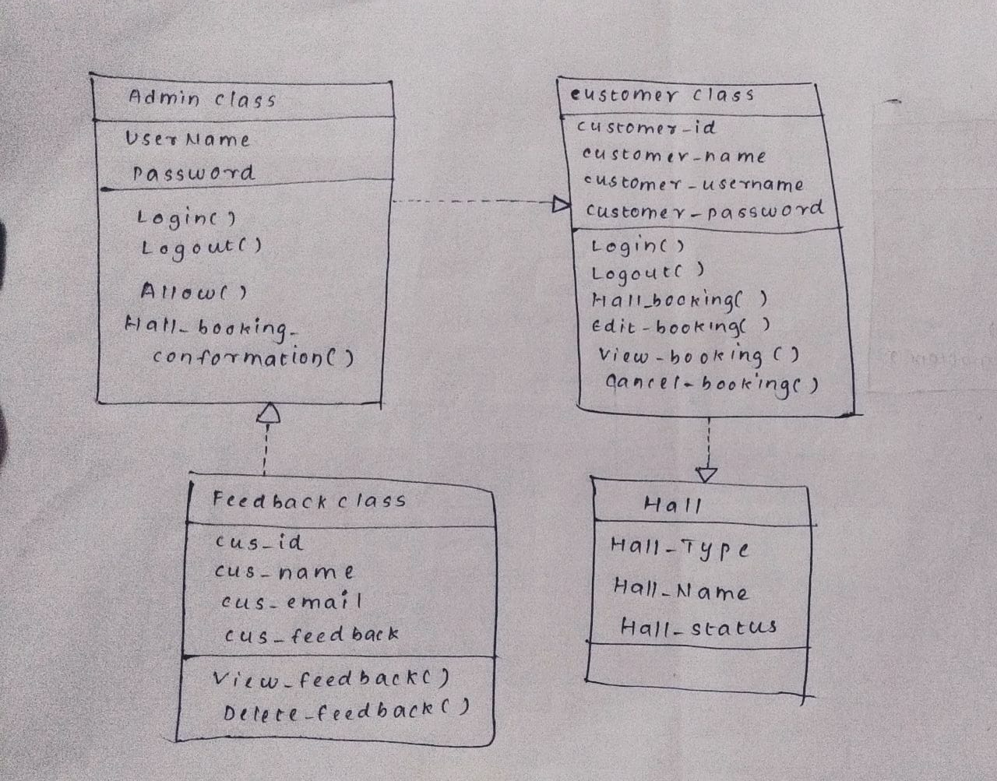
Class Diagram

Slide 8
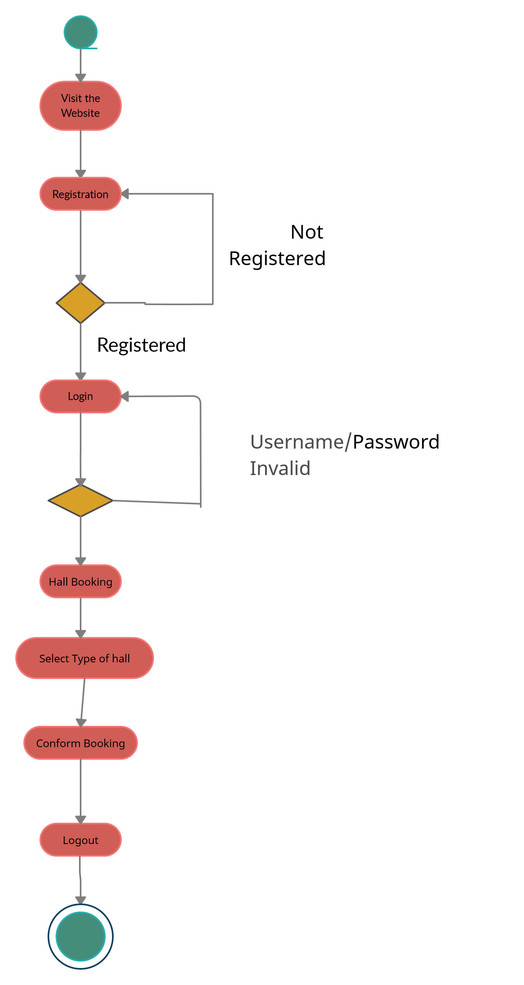
Activity diagram

Slide 9
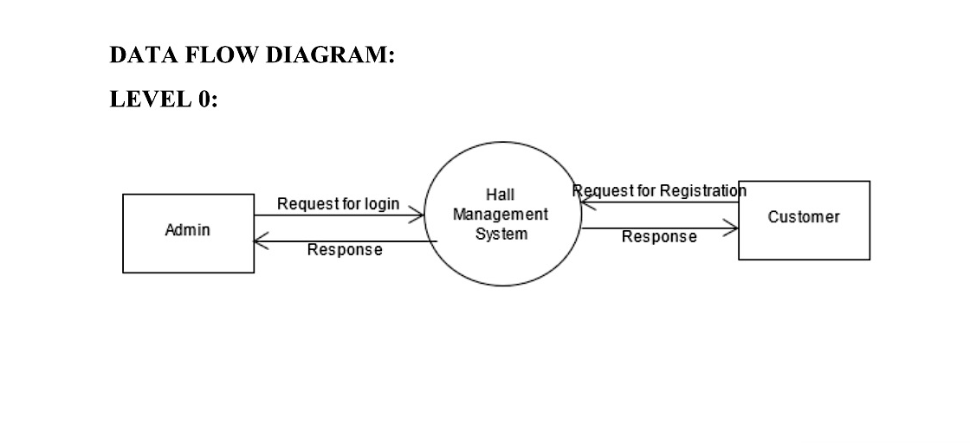
Data Flow Diagram

Slide 10
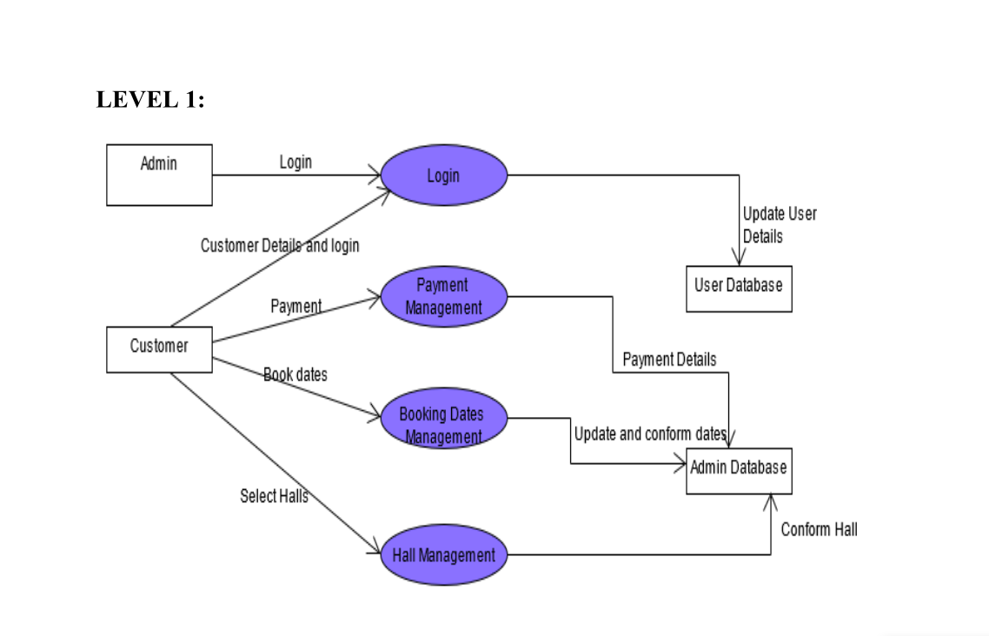
Level – 1 DFD

Slide 11
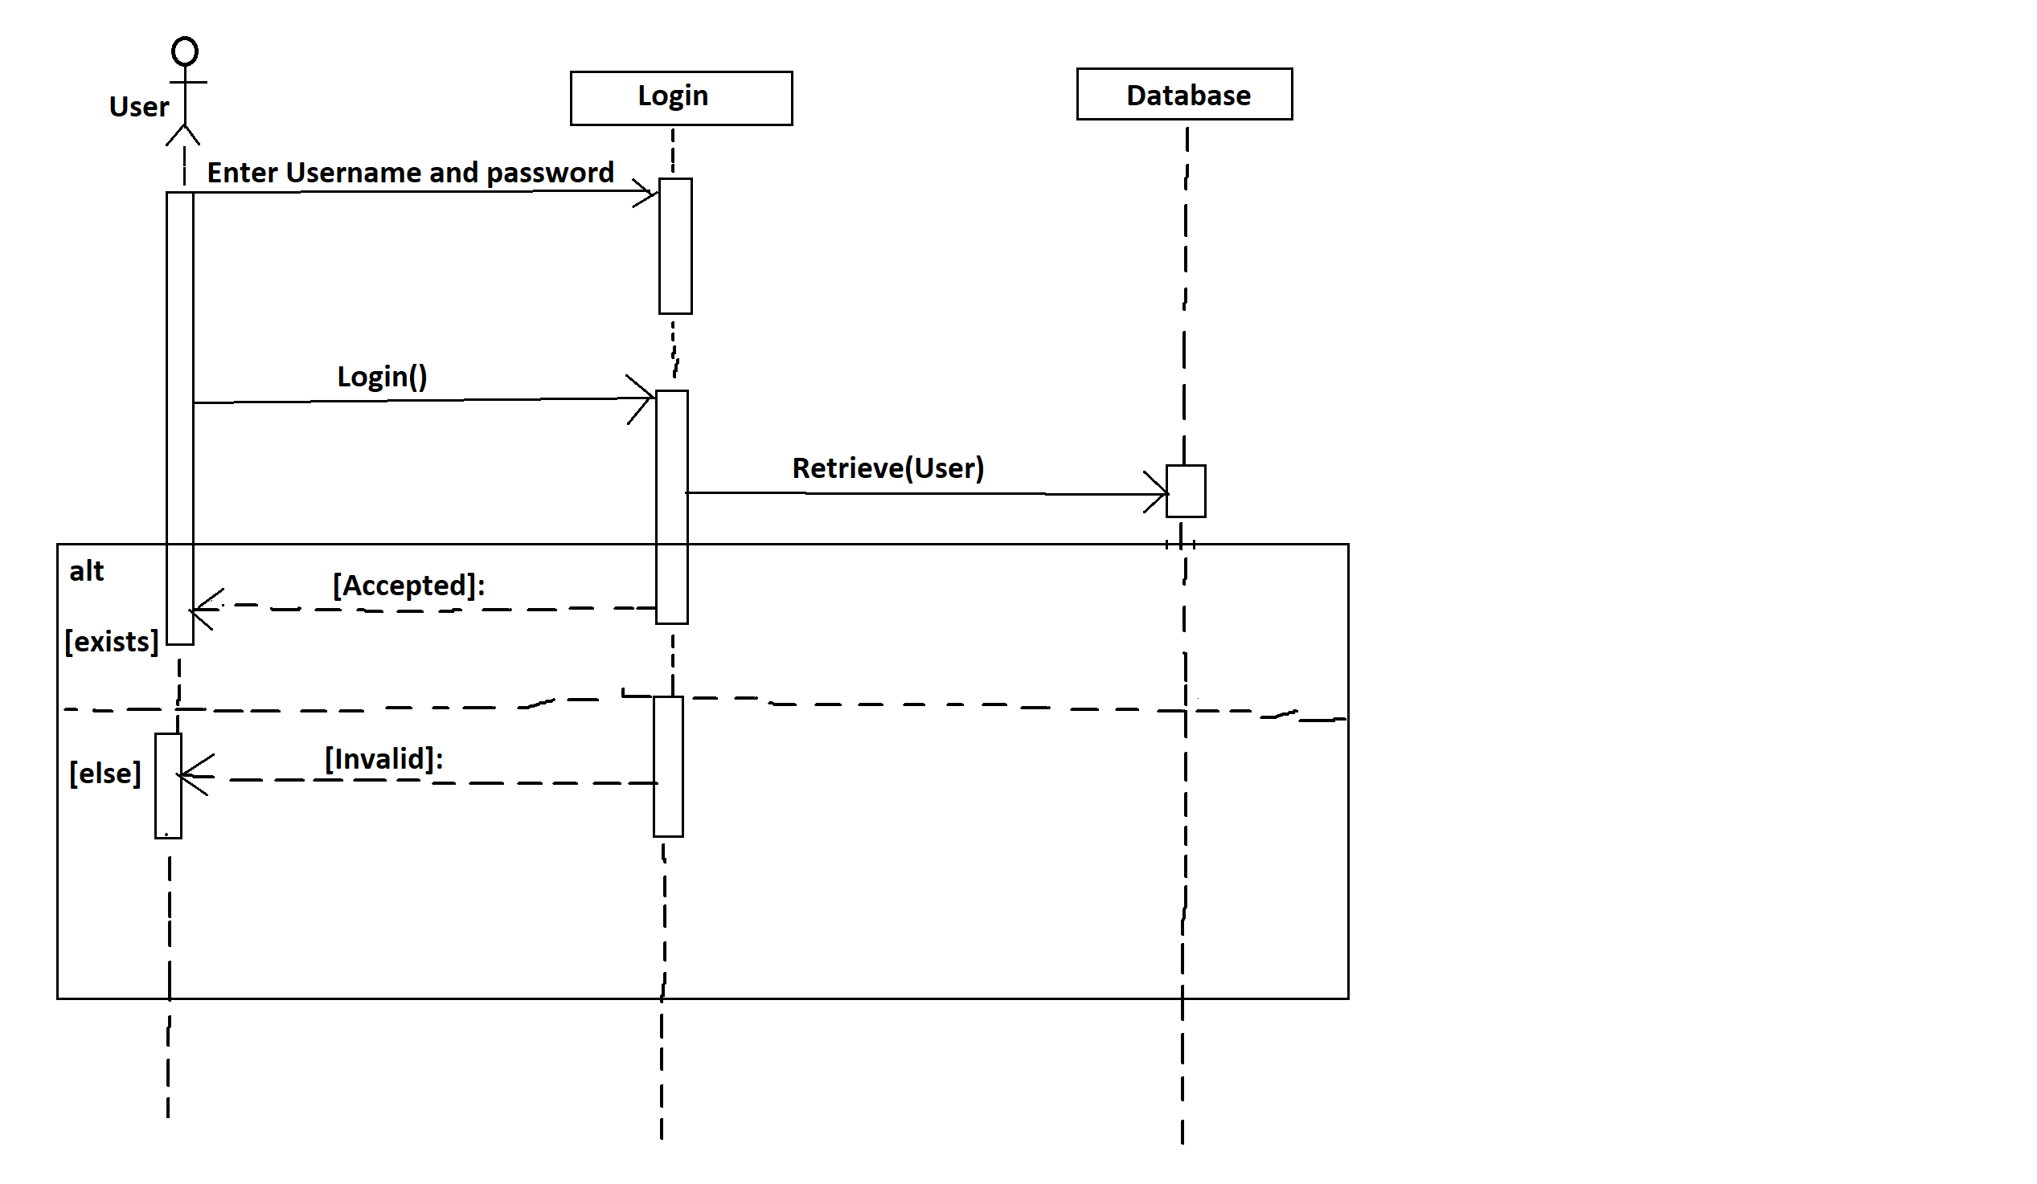
Sequence Diagram Login Sequence Diagram of Hall Booking

Slide 12
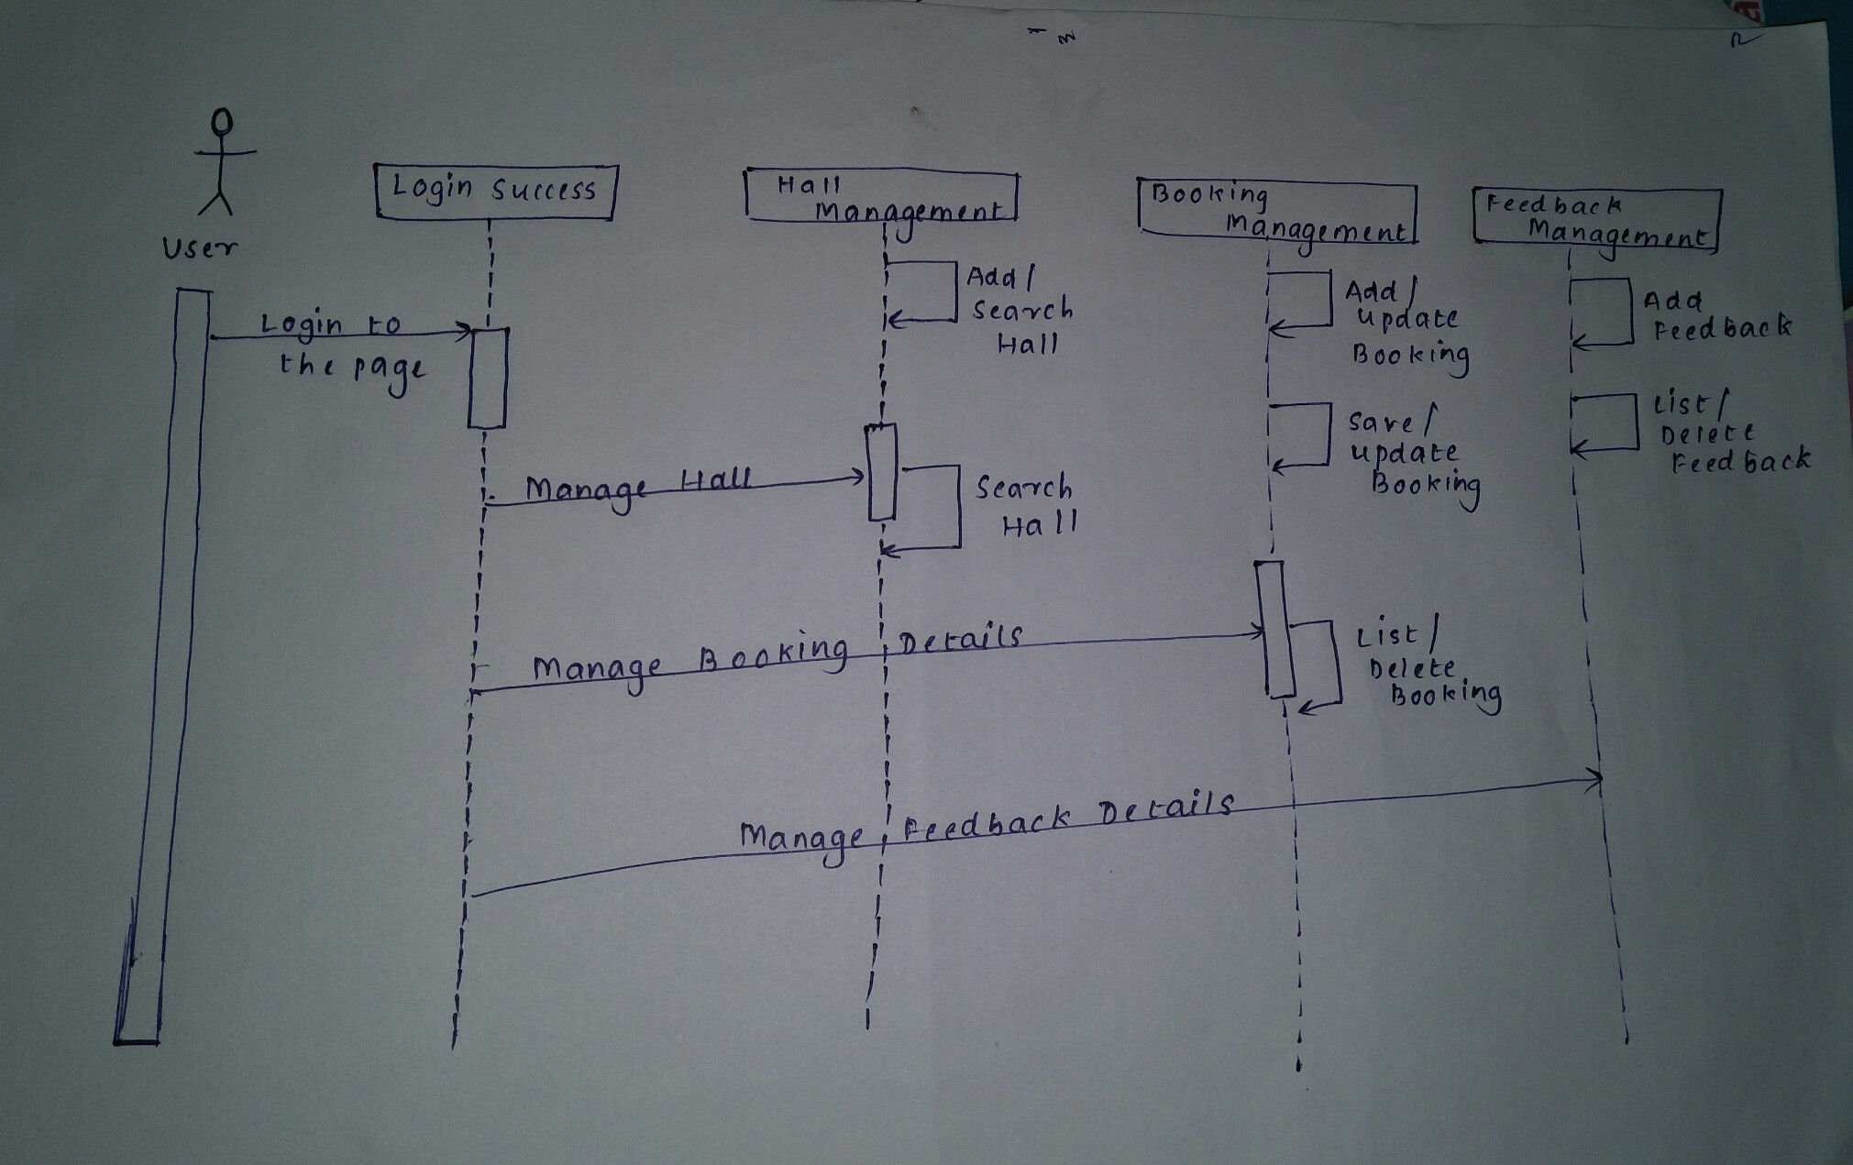
UML Sequence Diagram of Hall Booking

Slide 13
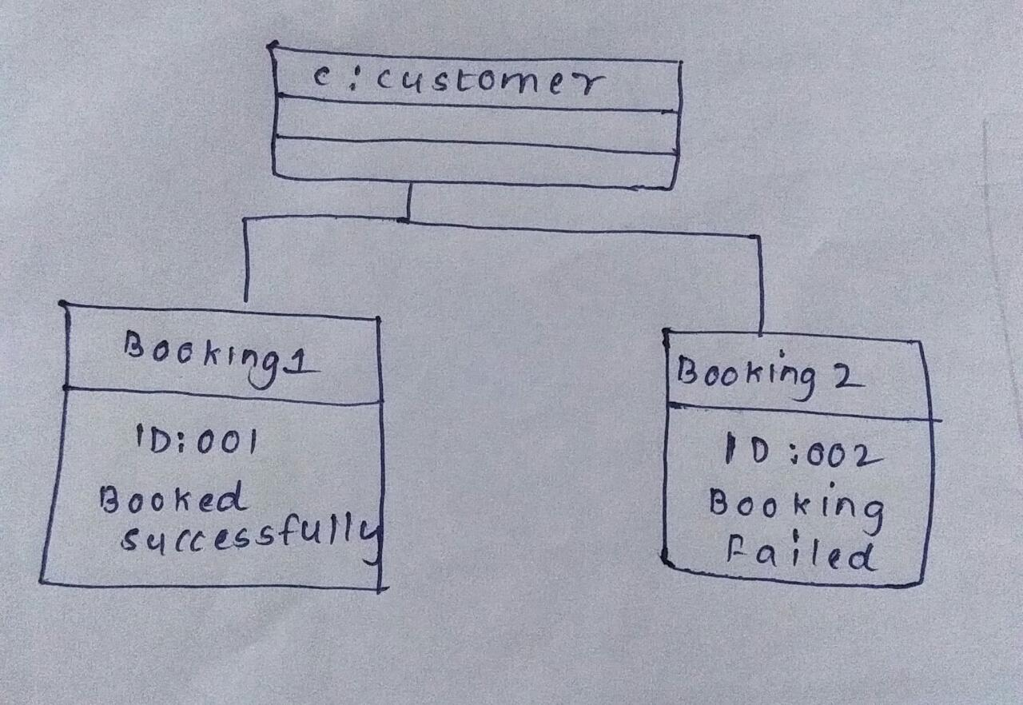
Object Diagram

Slide 14
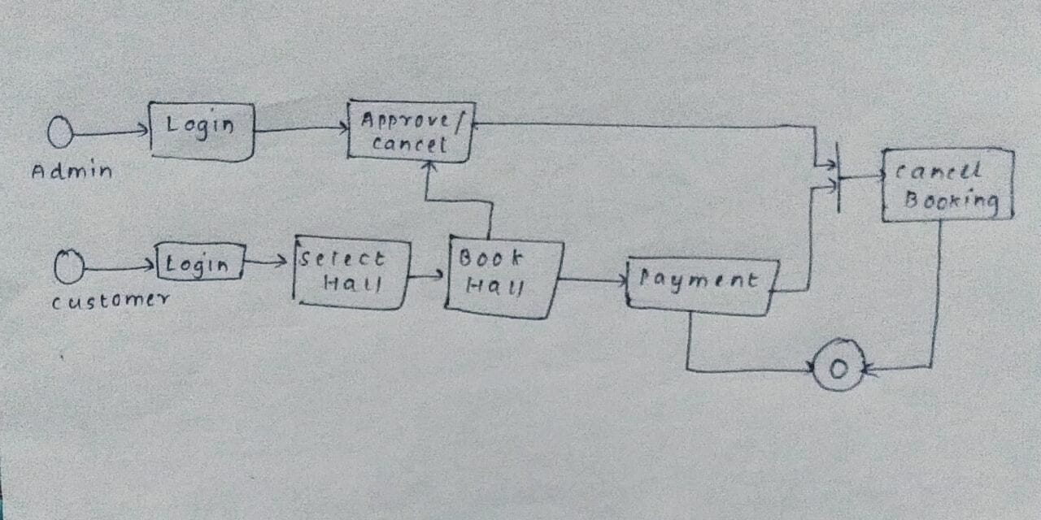
State Chart Diagram

Slide 15
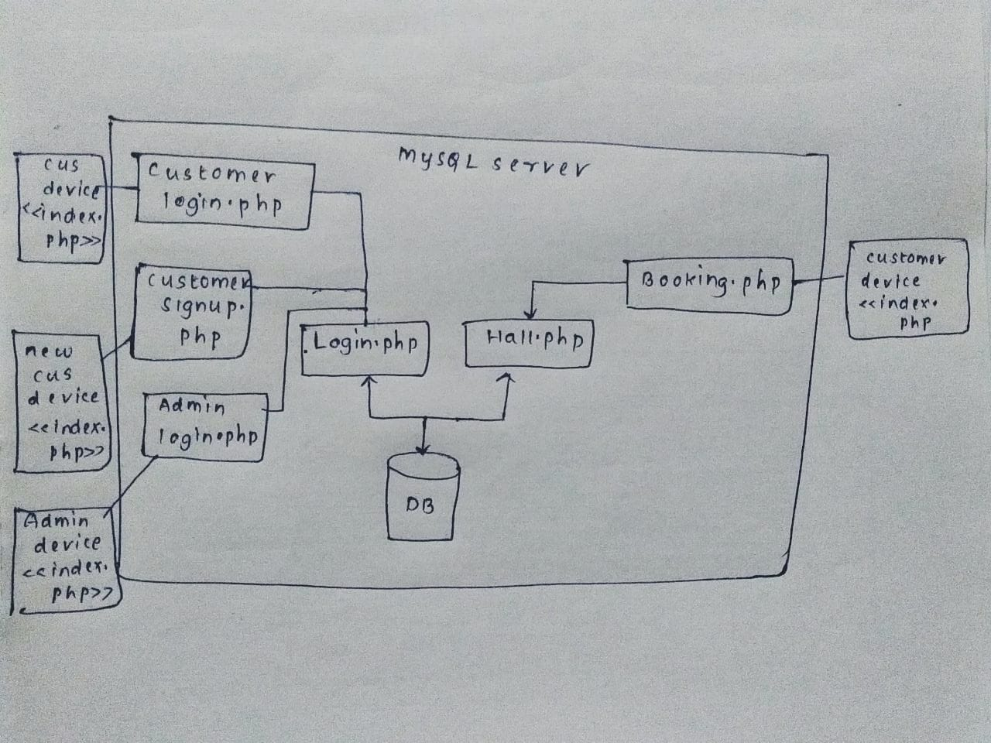
Deployment Diagram

Slide 16
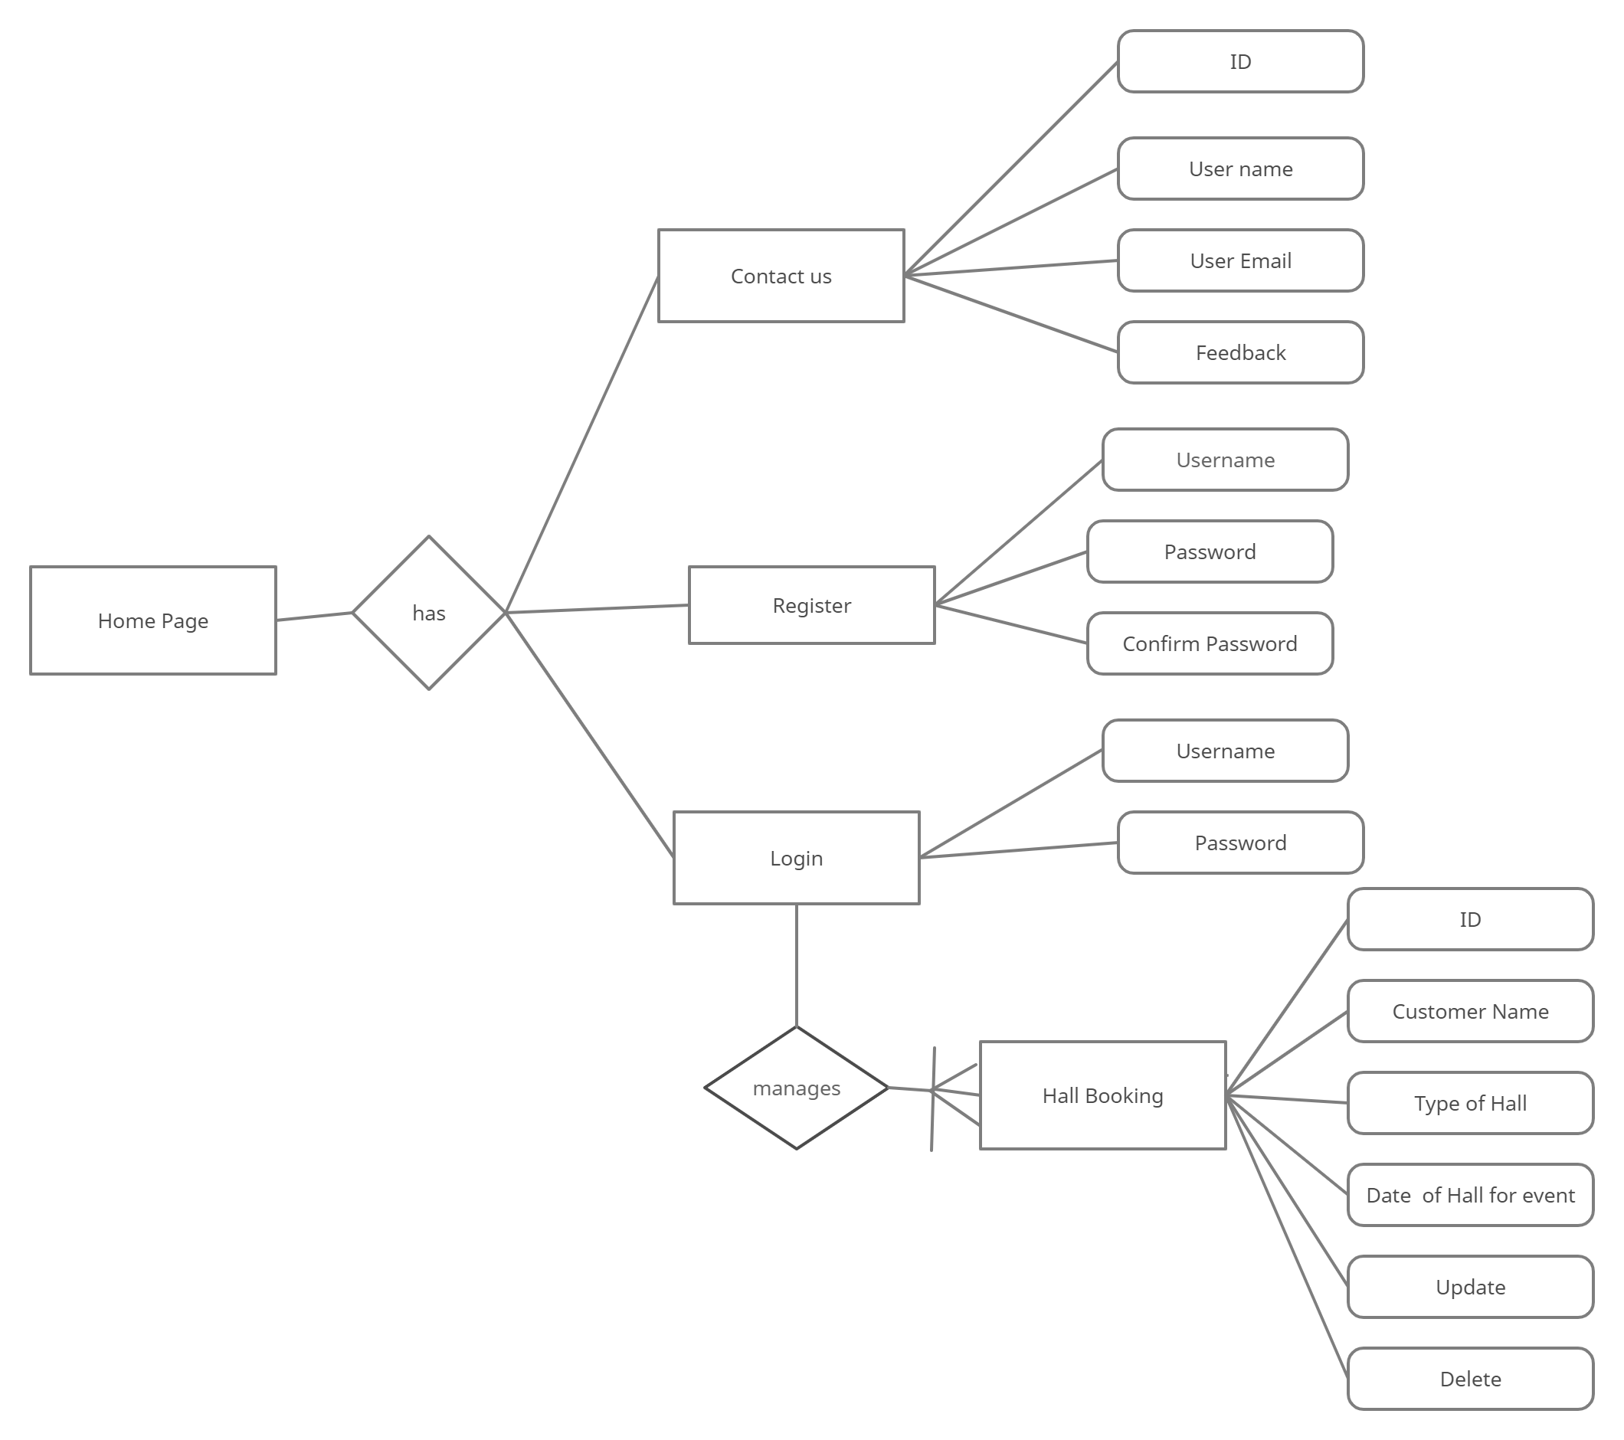
Database Design

Slide 17
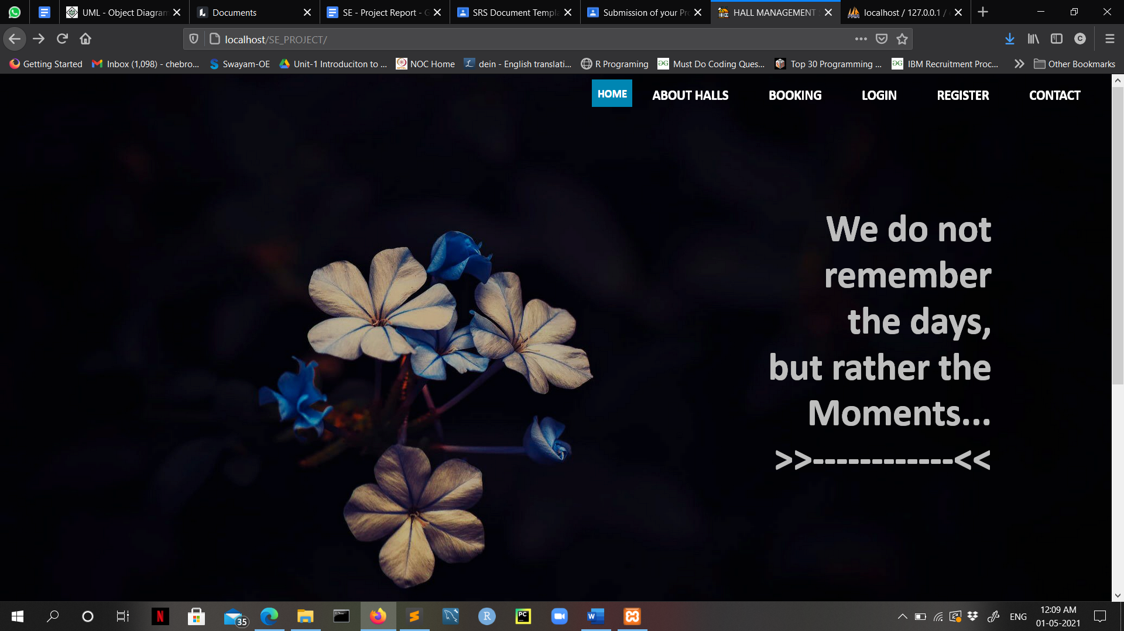
Output Main page

Slide 18
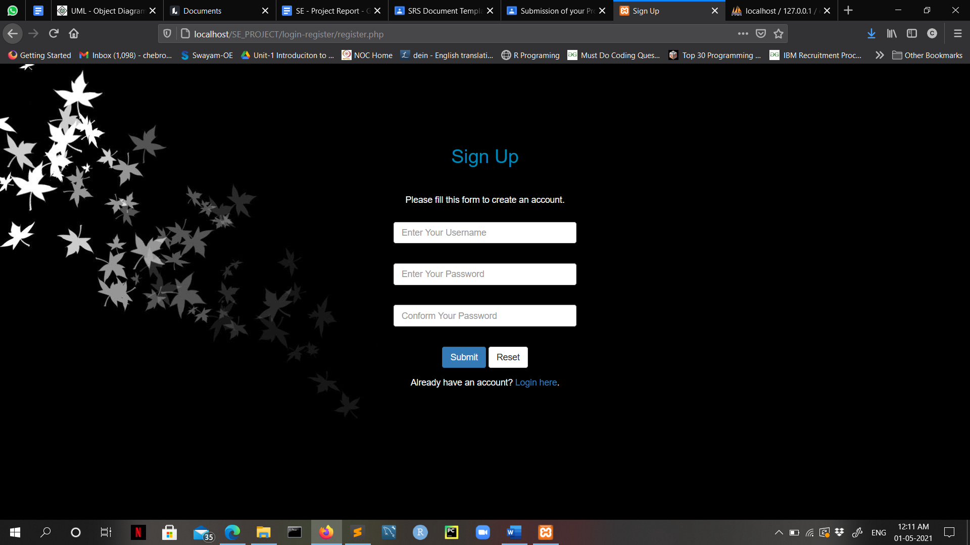
Creating Account

Slide 19
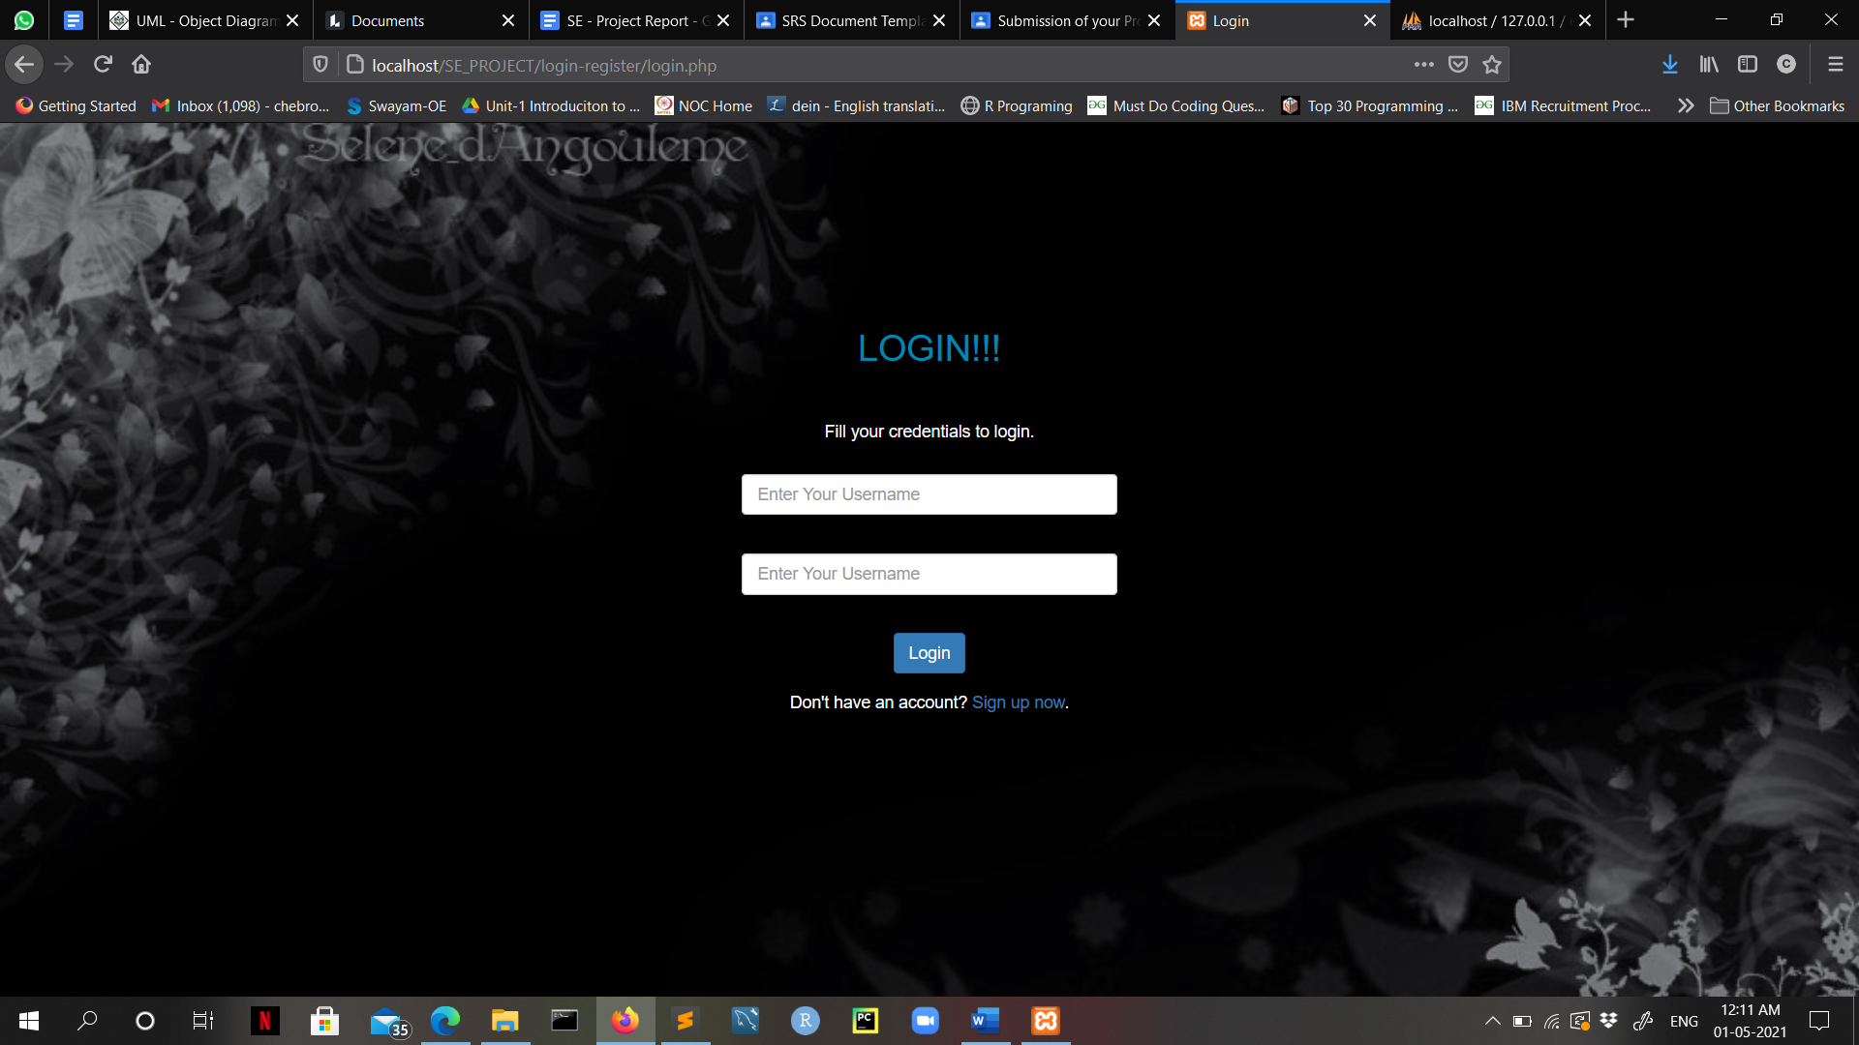
Login page

Slide 20
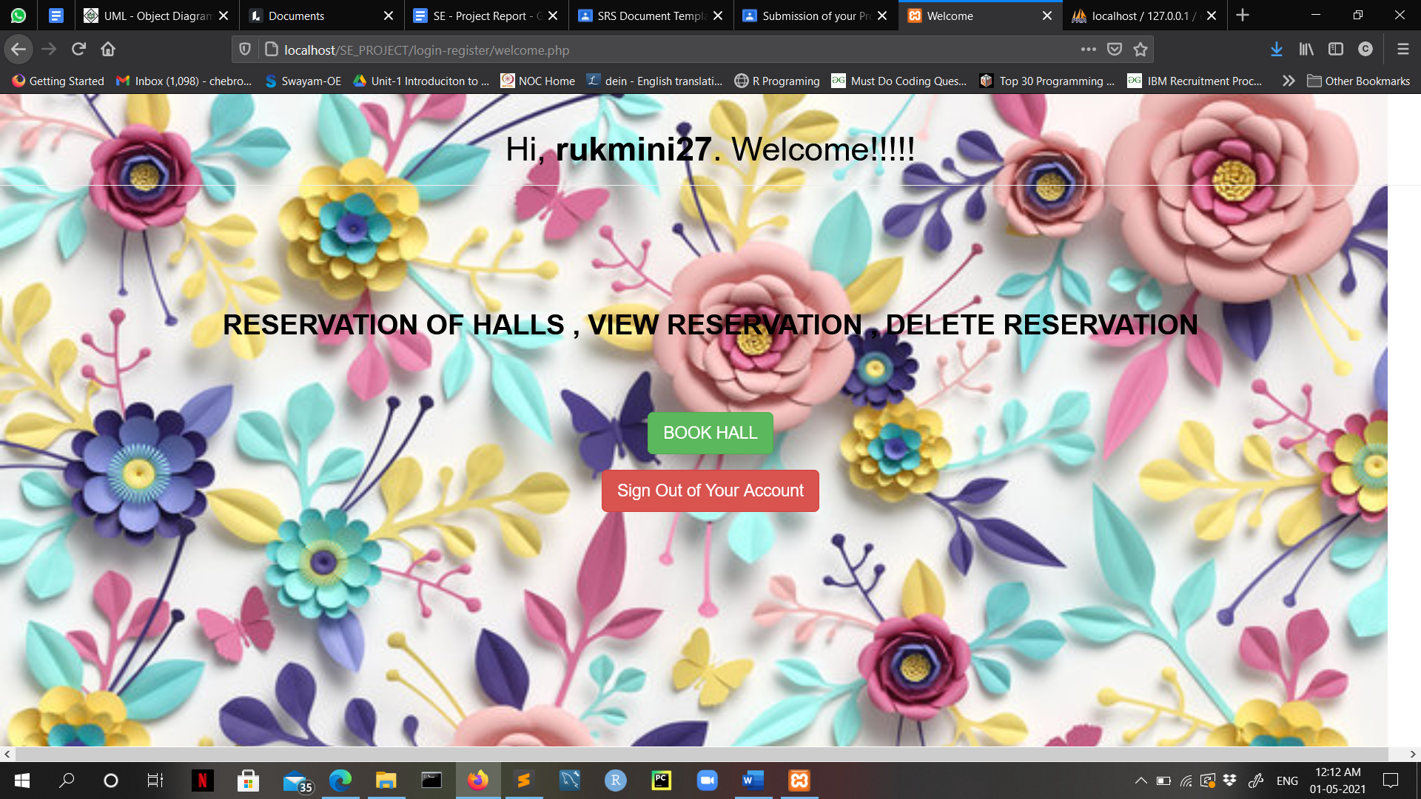
Sign out Account or Book Hall

Slide 21
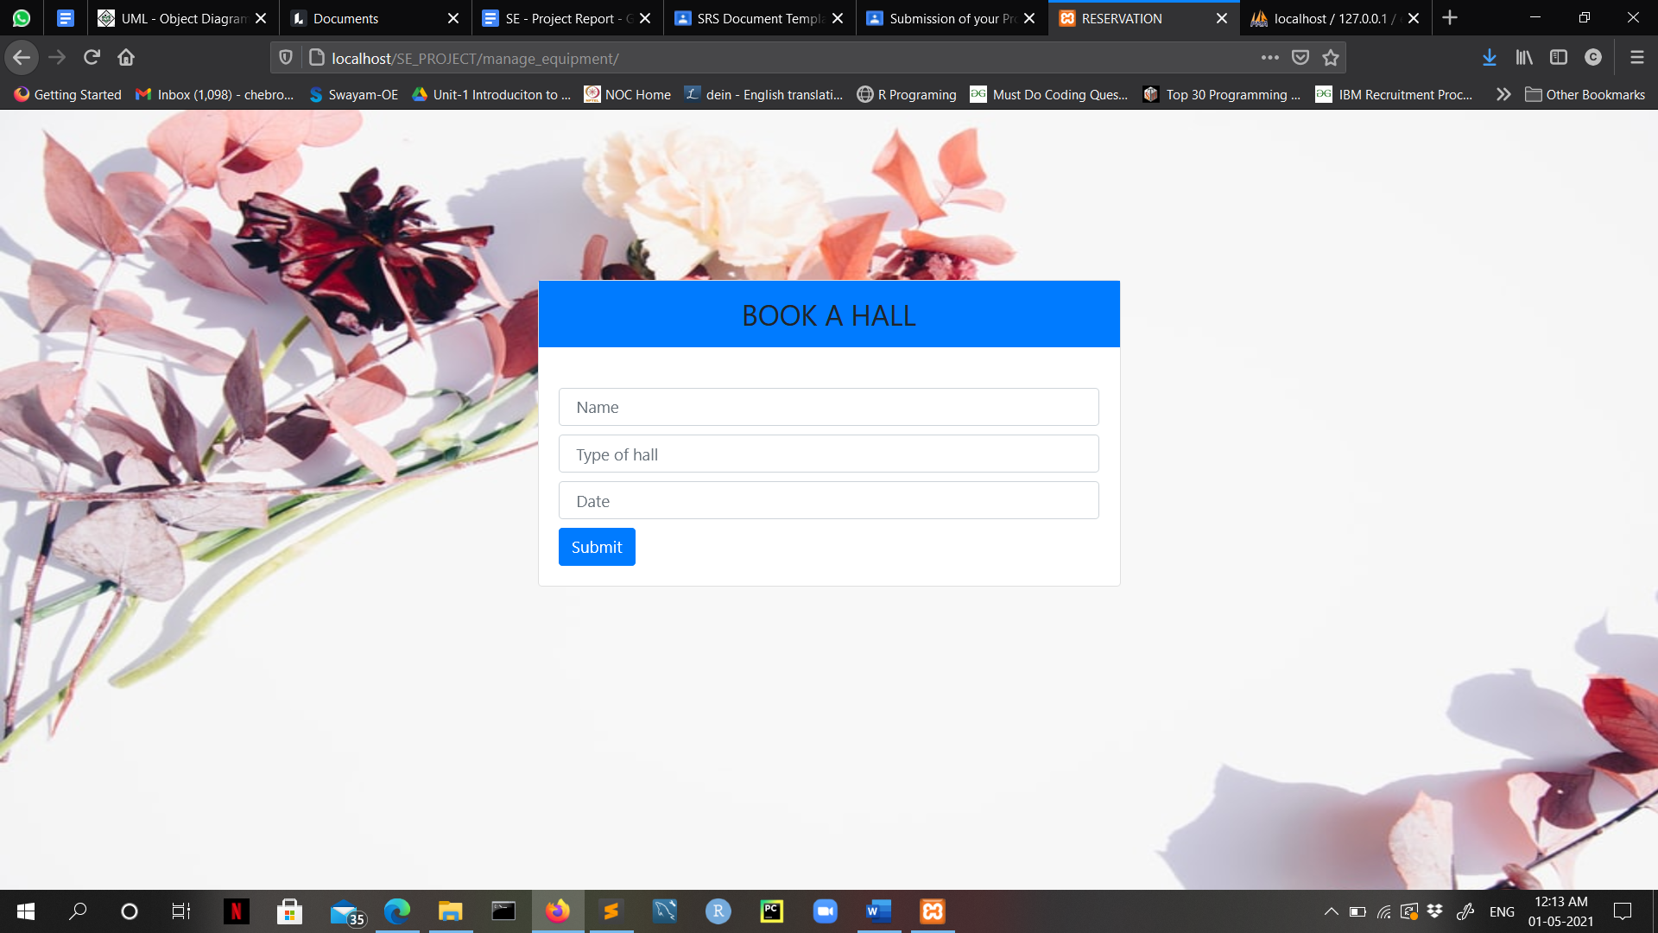
Booking Hall

Slide 22
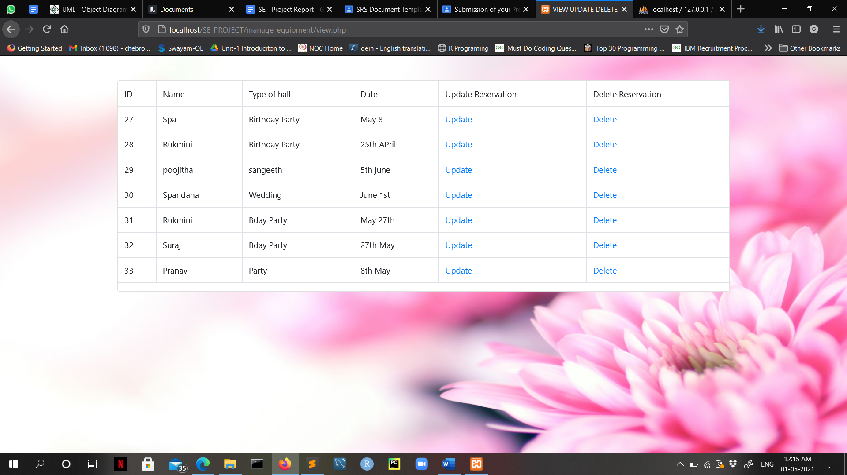
View, Update and Delete

Slide 23
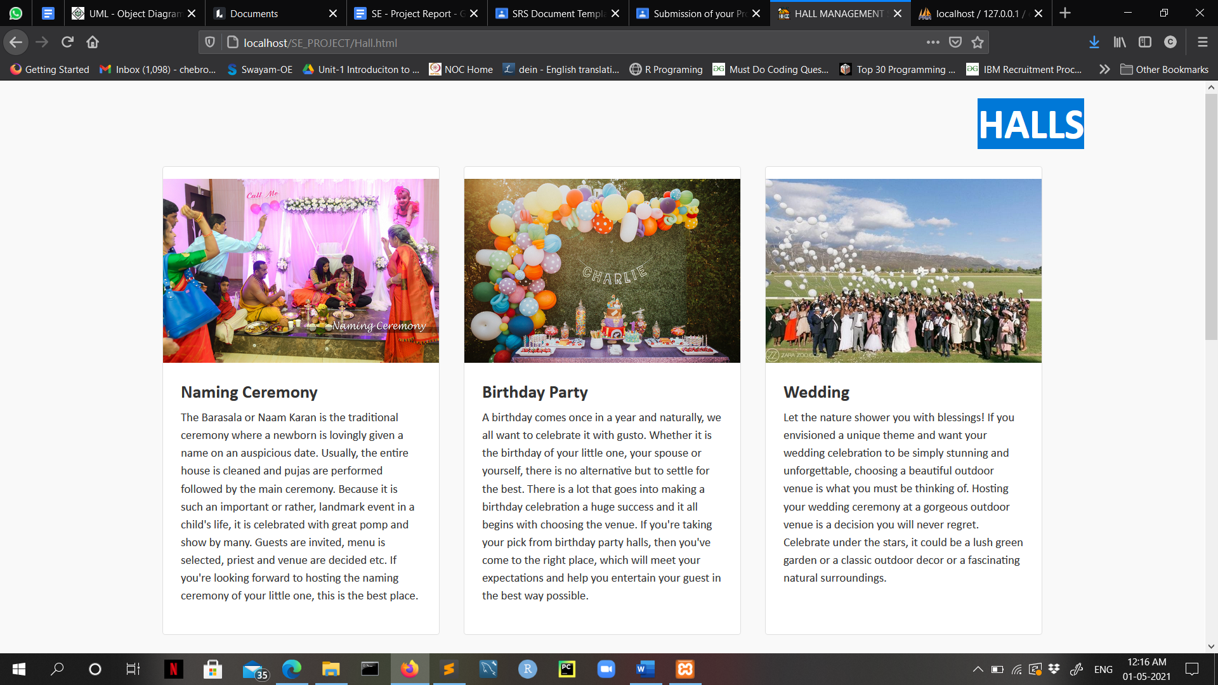
Hall Details

Slide 24
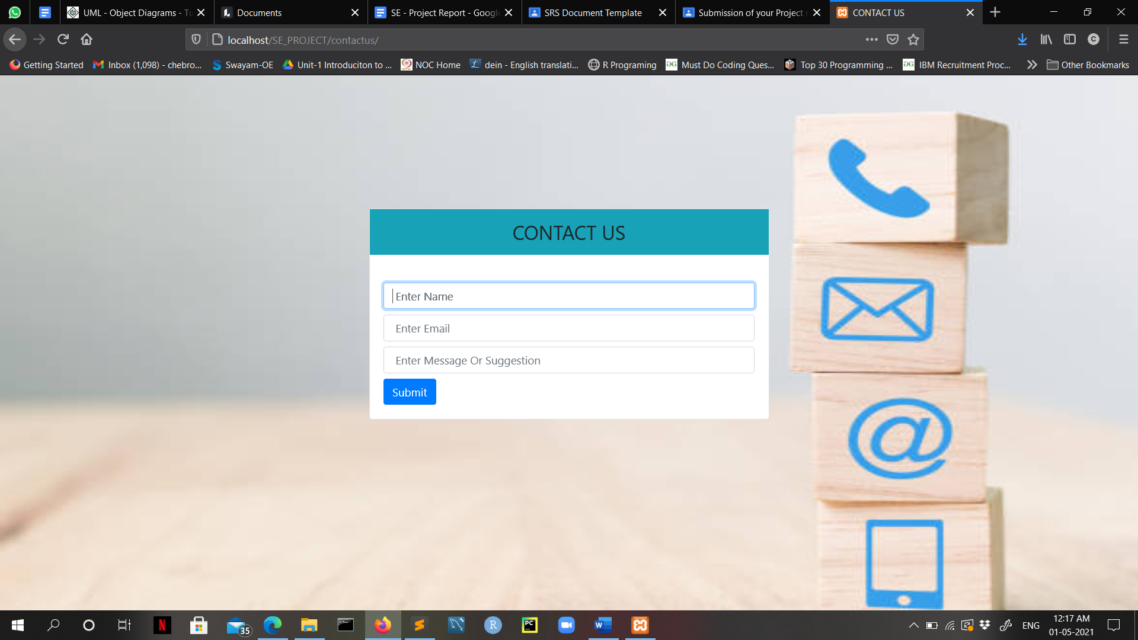
Feedback Page

